Slide 1
SWE-4805: Software Verification and Validation
Unit Testing
Md. Nazmul Haque
Lecturer, IUT
Department of Computer Science and Engineering
Islamic University of Technology
December 23, 2021

Slide 2
Contents
Contents
Unit testing

Slide 3
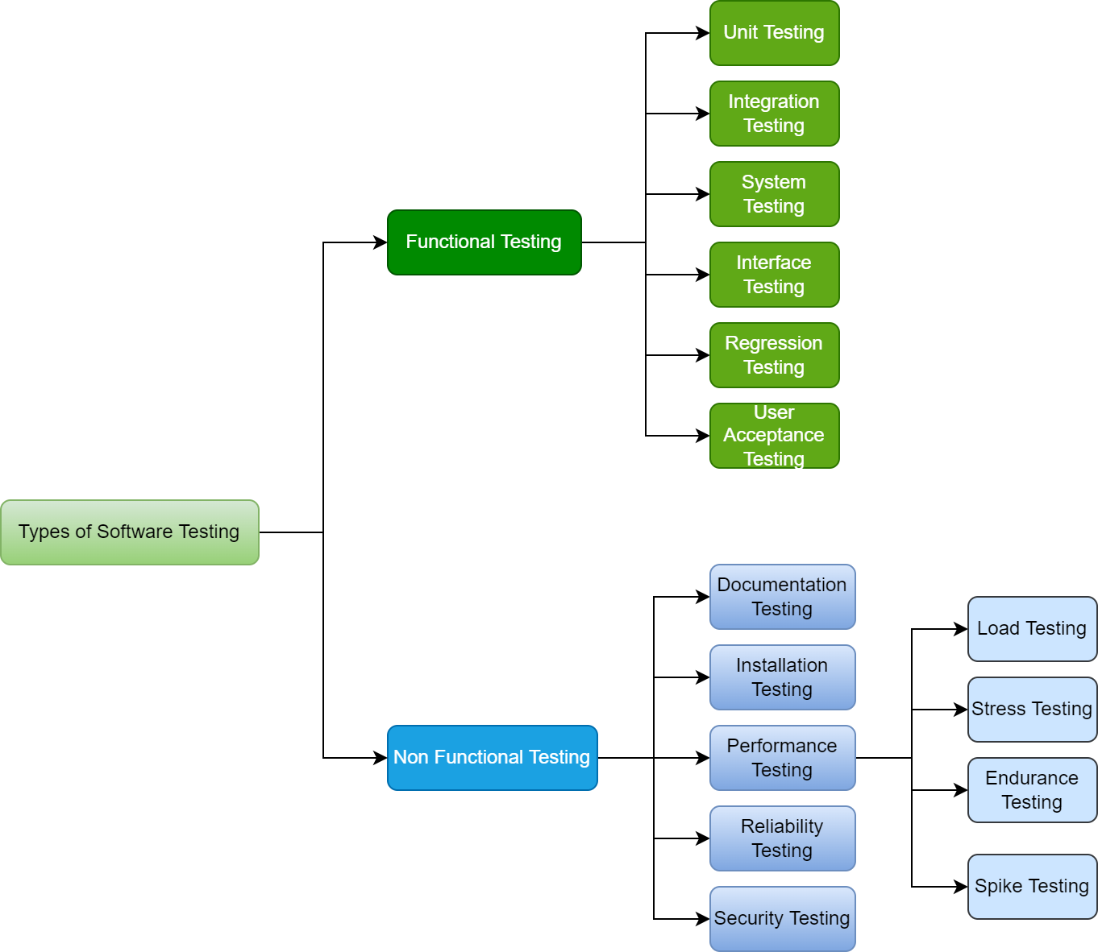
Verification
Types of Software Testing

Slide 4
Verification
Unit Testing
Unit testing is a way of testing the smallest piece of code referred to as a unit that can be logically isolated in a system. It is mainly focused on the functional correctness of standalone modules.

Slide 5
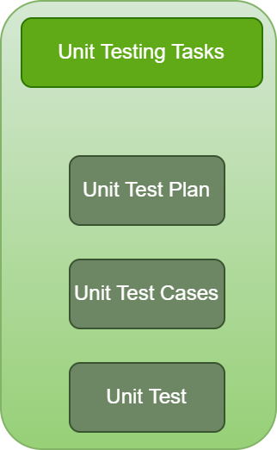
Verification
Unit Testing

Slide 6
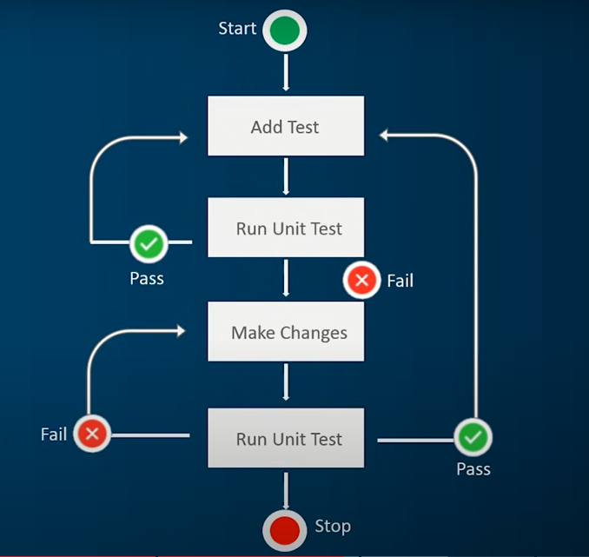
Verification
Unit Testing Algorithm

Slide 7
Verification
Benefits of Unit Testing
Makes coding practice more agile.
Improves the quality of the code.
Helps find software bugs early.
Facilitates changes & simplifies integration.
Provides documentation to developers.
Makes debugging easier and quicker.
Helps create better software designs.
Reduces testing cost.

Slide 8
Verification
How to write Unit testing
White-box testing covers the logic of the program, such as
Statement coverage
Decision/branch coverage
Condition coverage
Decision-condition coverage
Multiple condition
Black Box testing covers the functional specifications. Methods are-
Boundary Value Analysis (BVA)
Equivalence class testing
State table based testing
Decision table based testing
Cause effect graphing based testing

Slide 9
ANY QUESTION ?
THANK YOU !

Slide 10
Acknowledgements
Acknowledgements
[1] Chauhan, Naresh. Software Testing: Principles and Practices. Oxford university press, 2010.

